Slide 1
ROAD
ACCIDENTS
ANALYSIS
A COMPREHENSIVE STUDY
BY ADEL AIT SLIMANE

Slide 2
INTRODUCTION
Welcome to the presentation of Road Accidents Analysis.
This study delves into the patterns, trends, and predictive modeling of road accidents in the USA, using data from 2016 to 2023.

Slide 3
TABLE OF CONTENTS
1
2
3
4
5
6
DATA GATHERING
WEB SCRAPING
VISUALIZATIONS
MYSQL QUERIES
CREATING AN API
MACHINE LEARNING

Slide 4
LET’S START!

Slide 5
1
DATA GATHERING

Slide 6
HERE WE EXPLORE THE INITIAL STEPS TAKEN TO UNDERSTAND AND CLEAN THE DATASET.
Initial data loading and cleaning.
Summary statistics of key variables.
Identification of missing values and handling strategies.

Slide 7
Dataset found on Kaggle compiling 7 years of road accidents in the USA between 2016 and 2023.
At first dataset contained 7.7M rows.
After cleaning and checking for duplicates, the dataset is now filled with 3.5M rows.

Slide 8
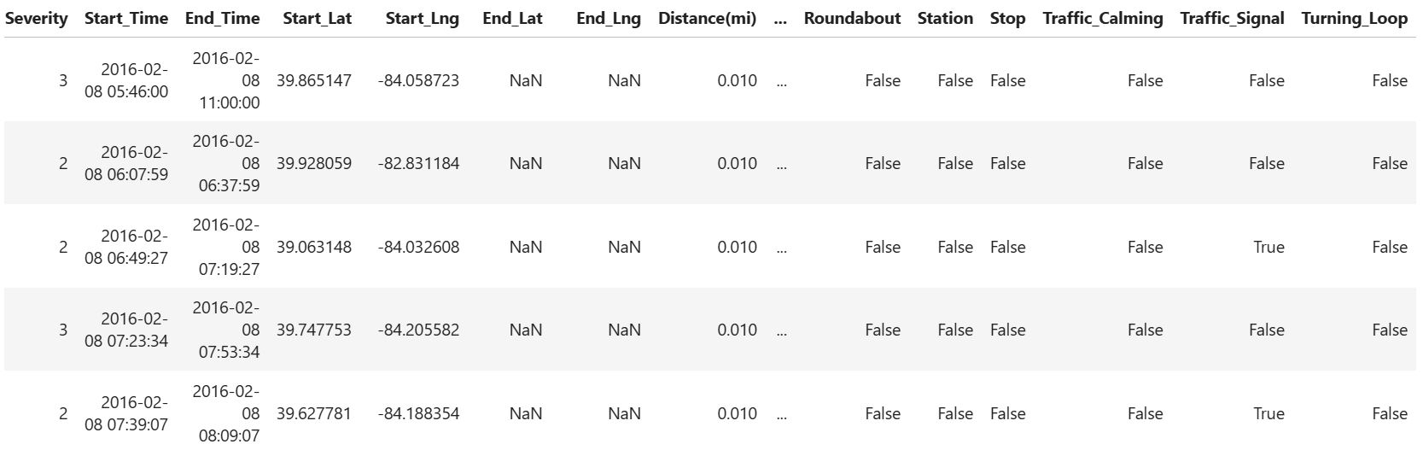
DATASET OVERVIEW

Slide 9
2
WEB
SCRAPING

Slide 10
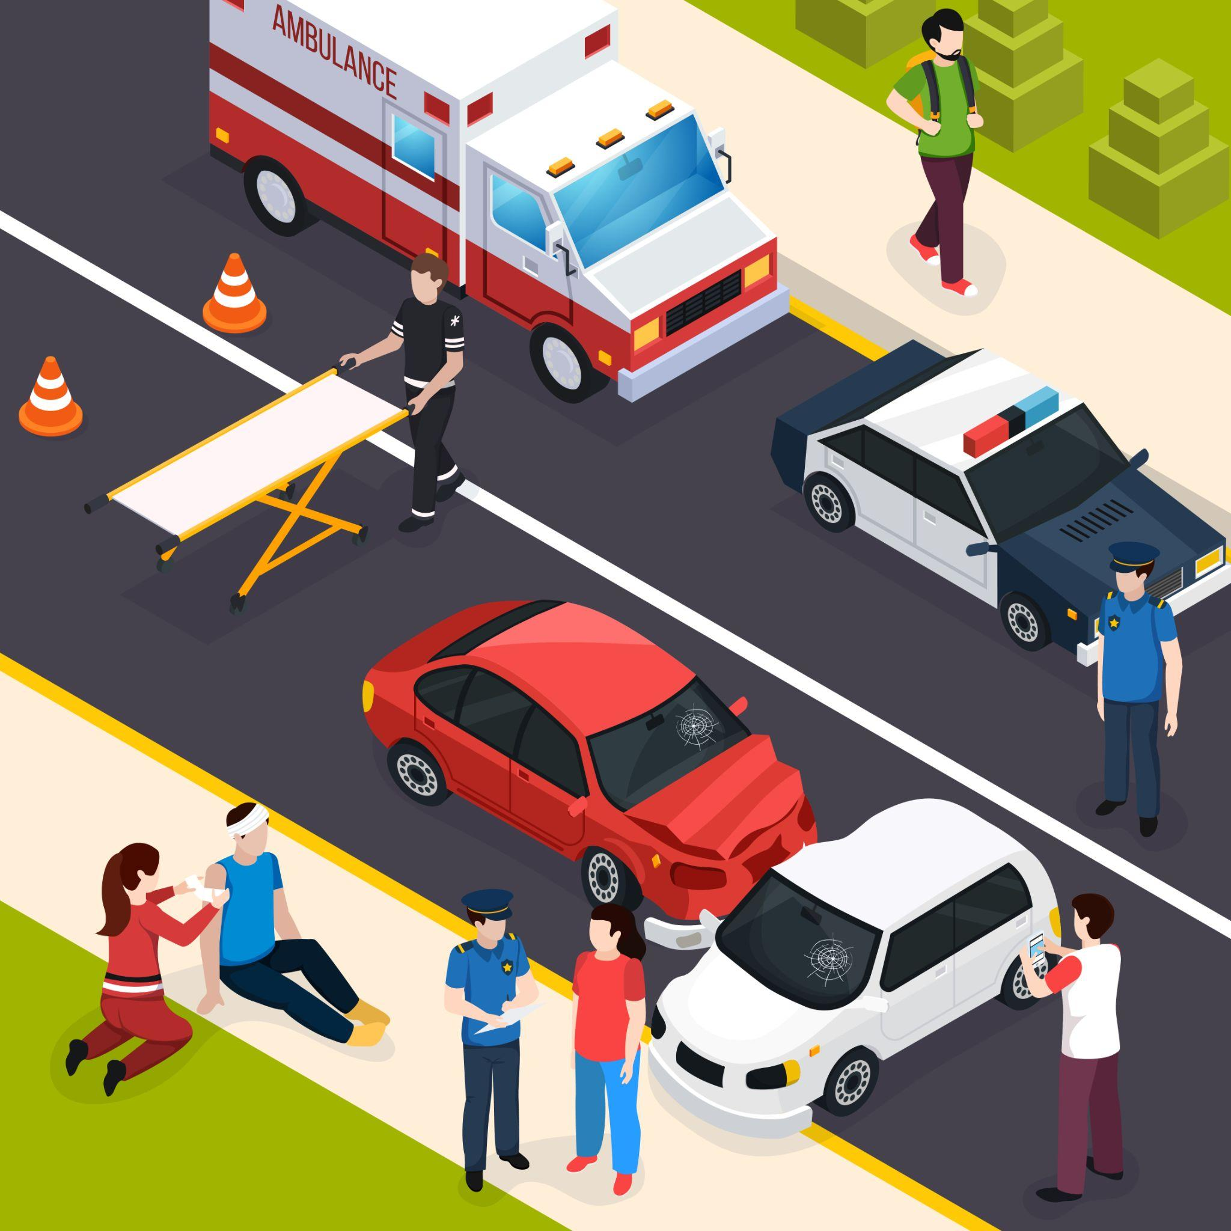
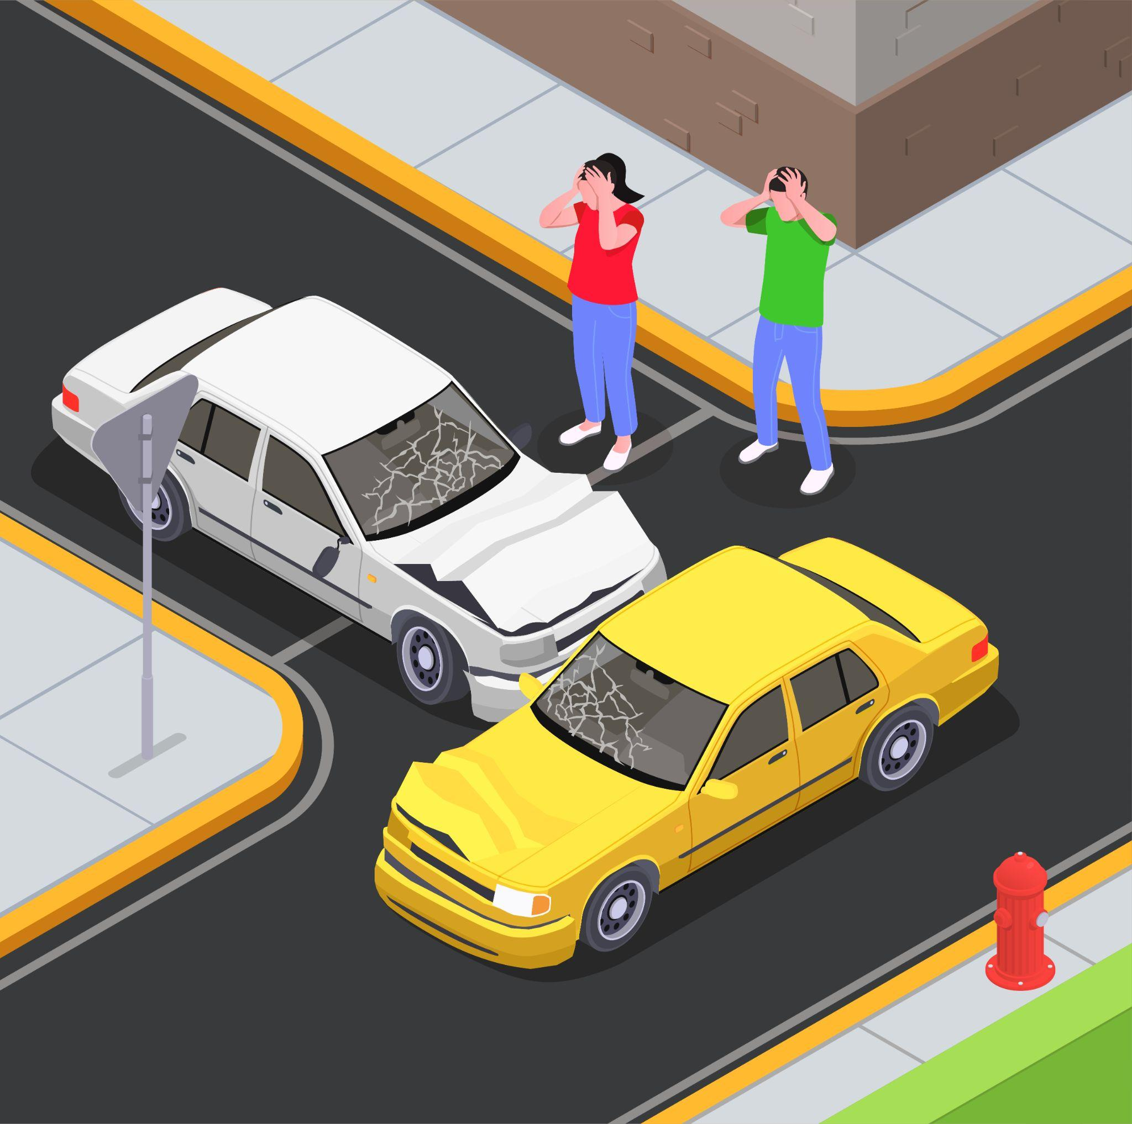
THESE SLIDES EXPLAIN THE TECHNIQUES USED TO GATHER ADDITIONAL DATA THROUGH WEB SCRAPING
Techniques used to scrape population data from Wikipedia.
Implementation of results.
Notes:
sul

Slide 11
Webscraping done using Beautifulsoup in Wikipedia web page.
A dataframe is created using the new informations.
The new dataframe is merged to the dataframe project with more precise details.

Slide 12
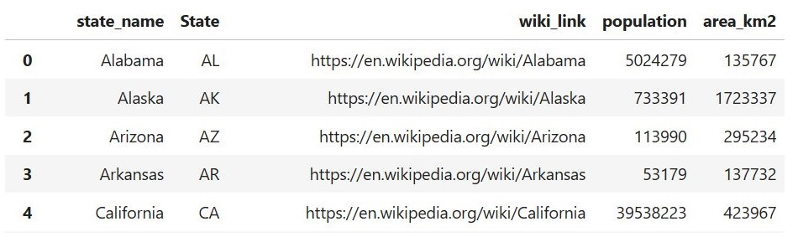

Slide 13
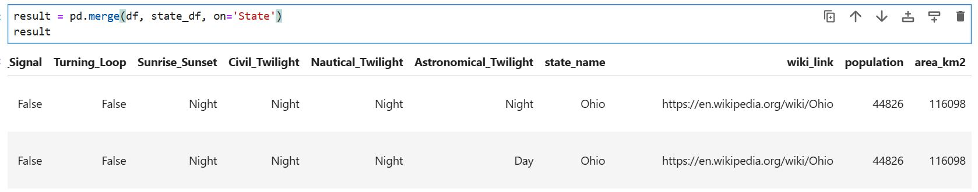

Slide 14
3
VISUALIZATIONS

Slide 15
THIS SECTION ILLUSTRATES THE VARIOUS VISUAL TECHNIQUES USED TO INTERPRET THE DATA.
Various visualizations to understand data distribution and relationships.
Examples include:
Bar charts showing accident counts.
Heatmap.
Map.

Slide 16
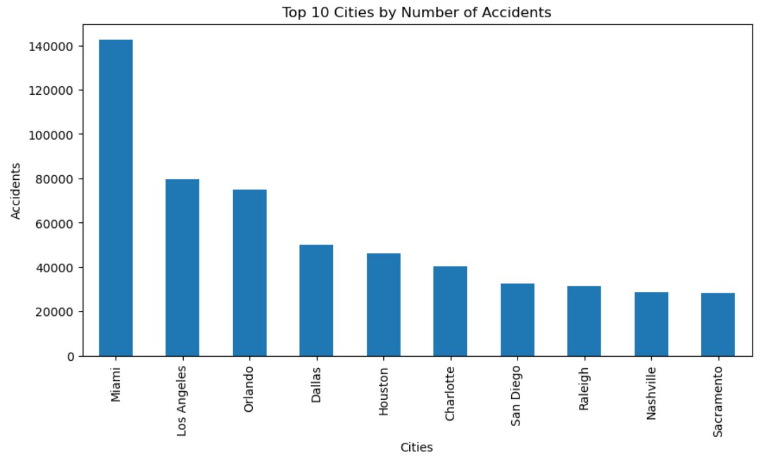

Slide 17
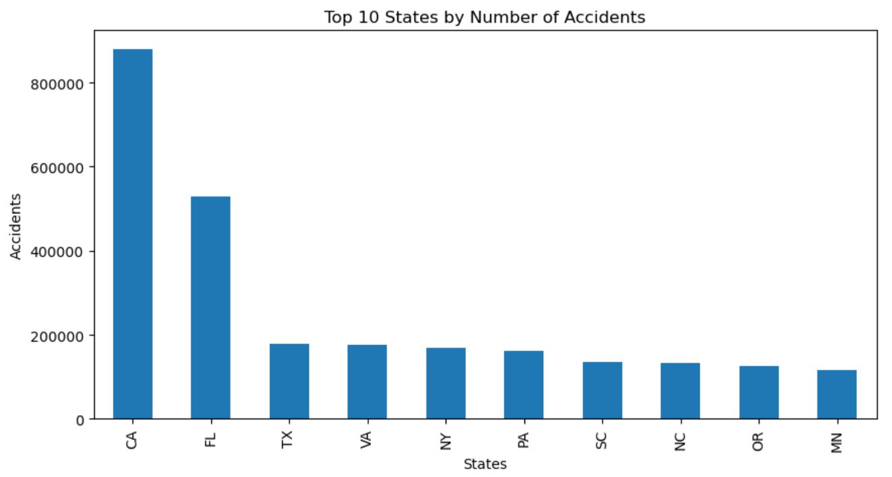
A PICTURE IS WORTH A THOUSAND WORDS

Slide 18
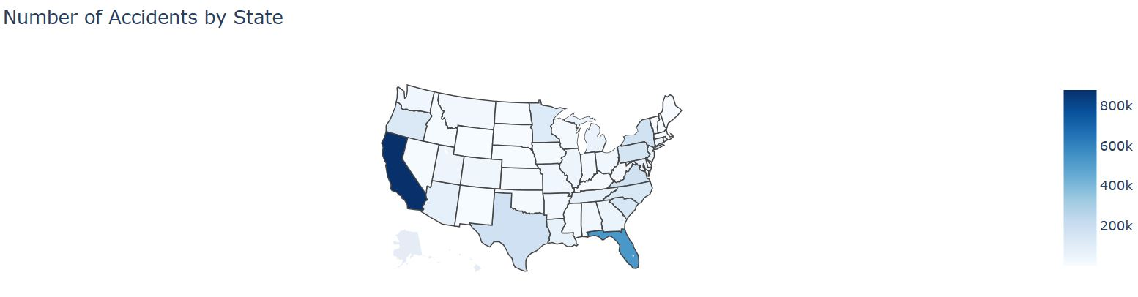

Slide 19
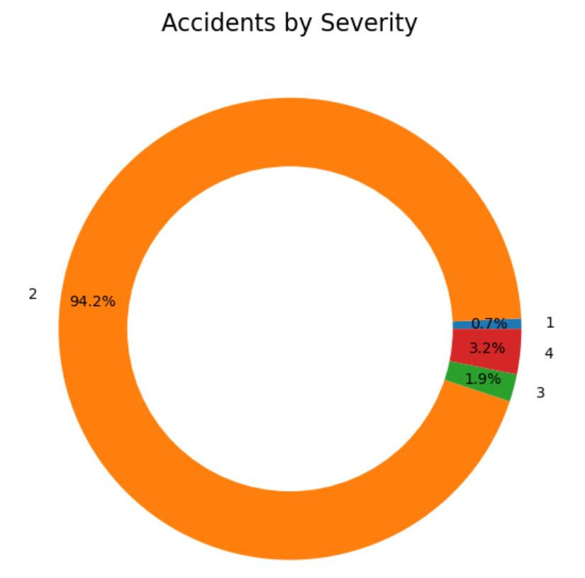

Slide 20
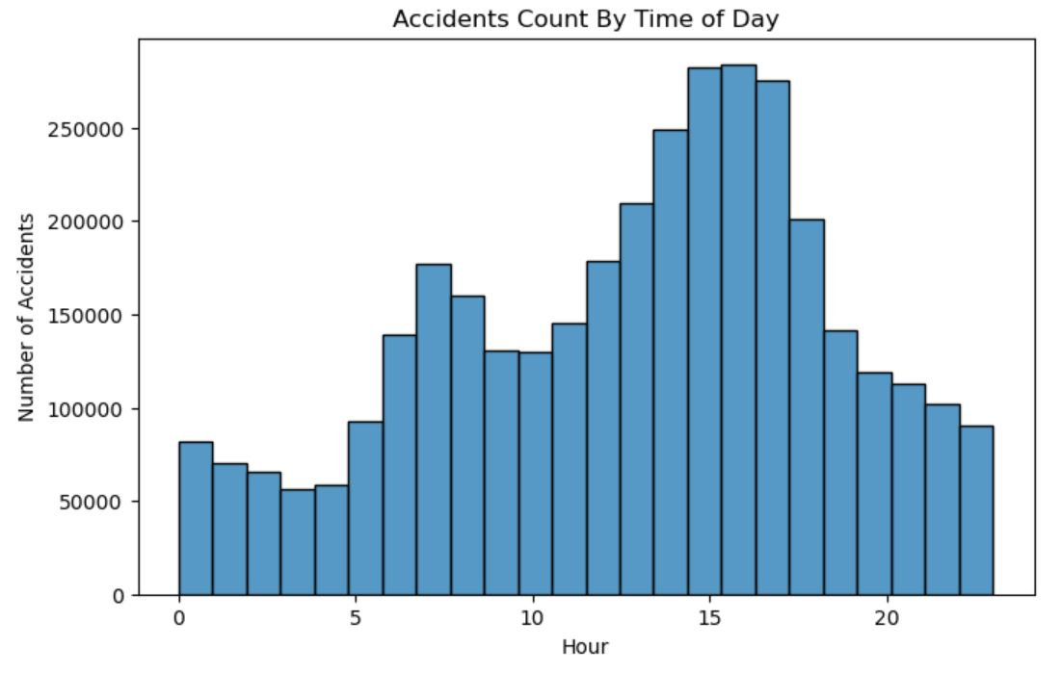

Slide 21
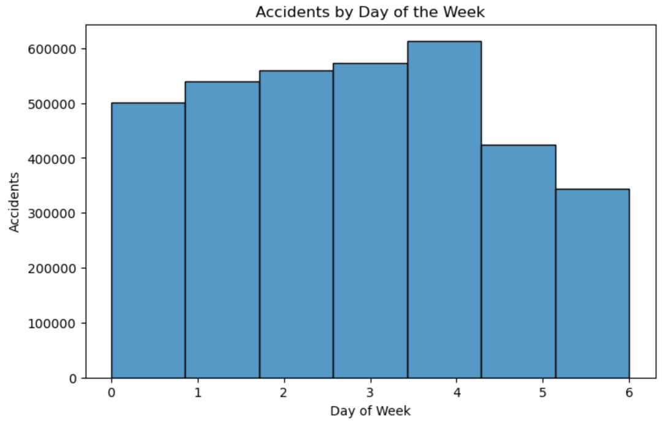

Slide 22
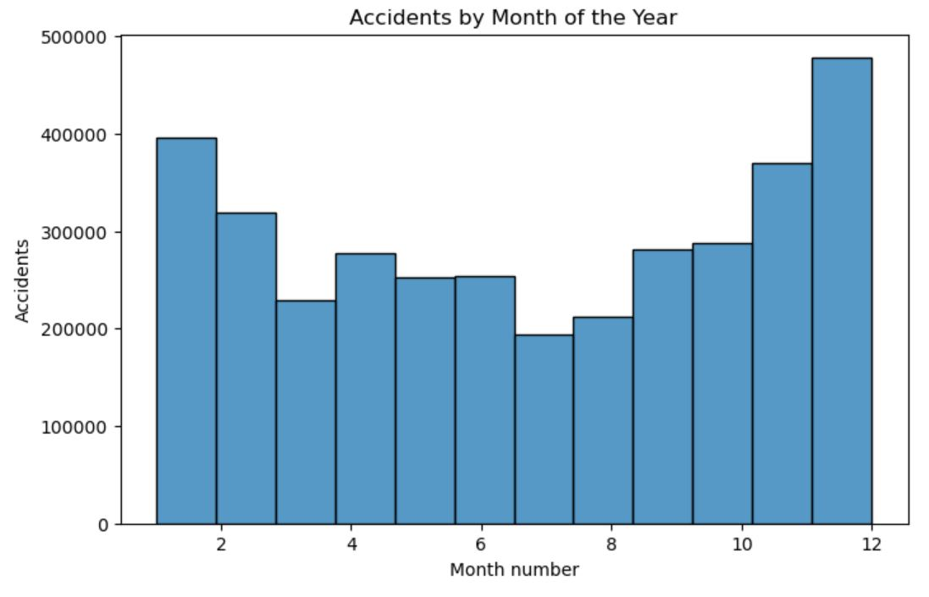

Slide 23
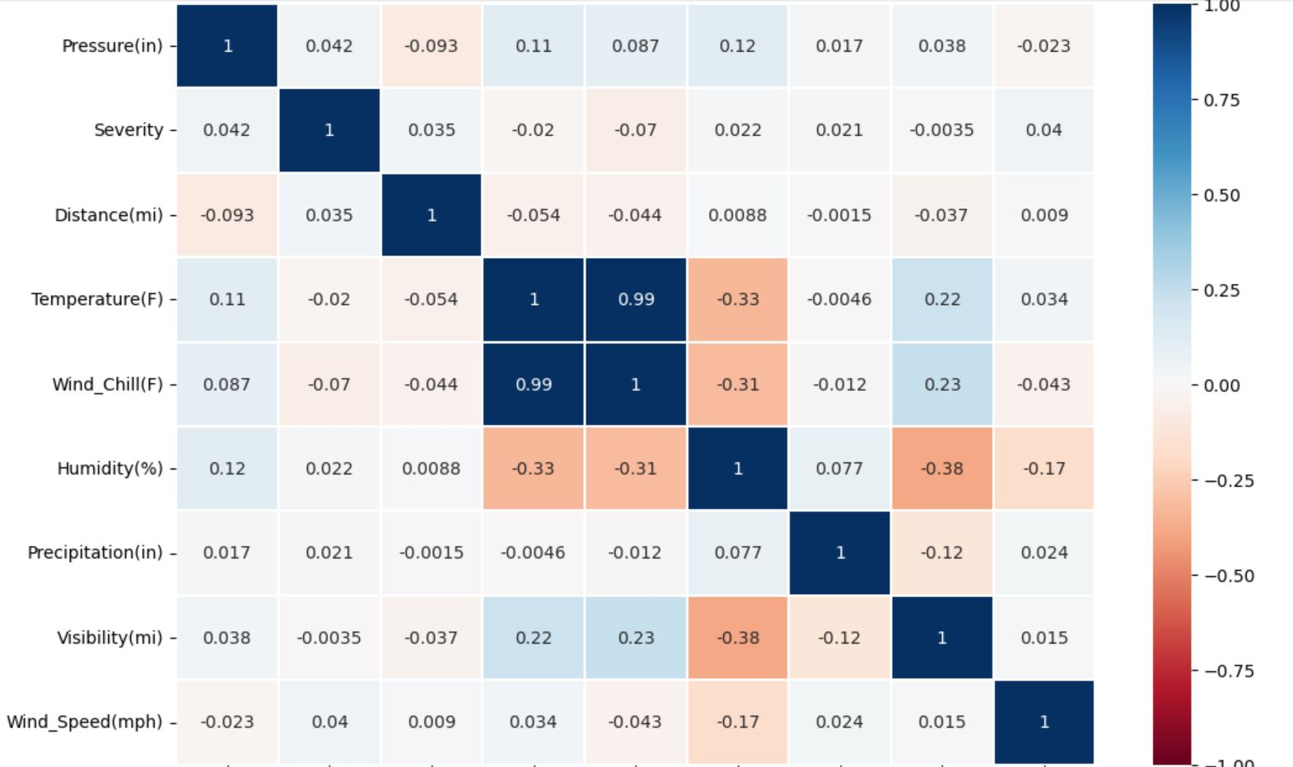
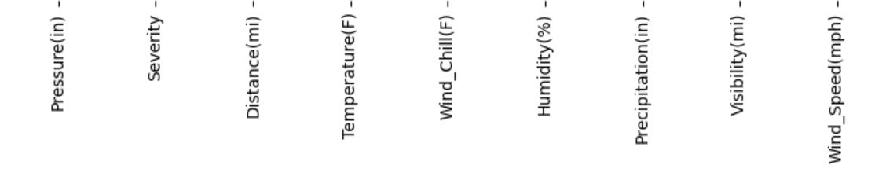

Slide 24
4
MYSQL
QUERIES

Slide 25
THIS PART COVERS THE DATABASE DESIGN AND SQL QUERIES FOR DATA ANALYSIS.
Database schema design for storing road accident data.
Key SQL queries used for data retrieval and analysis.

Slide 26
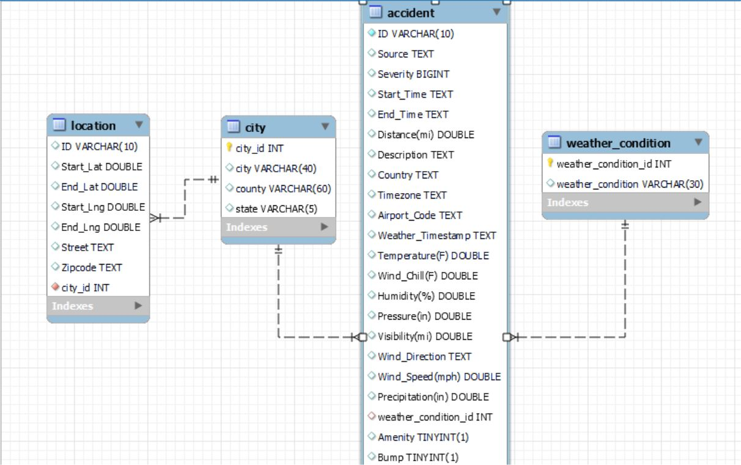

Slide 27
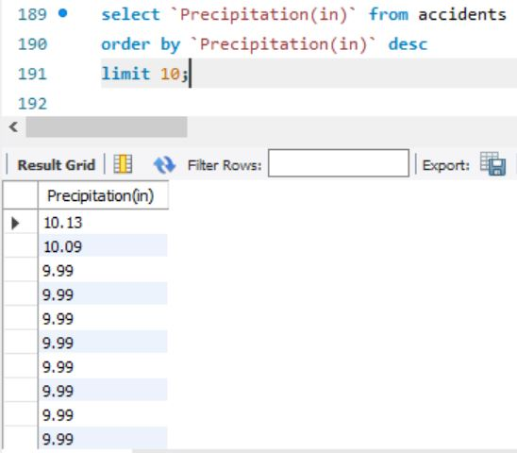

Slide 28
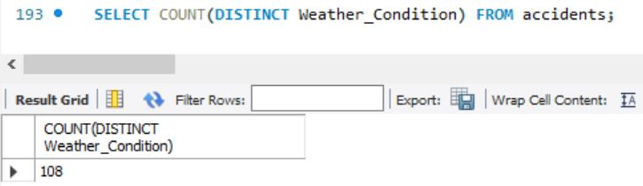

Slide 29
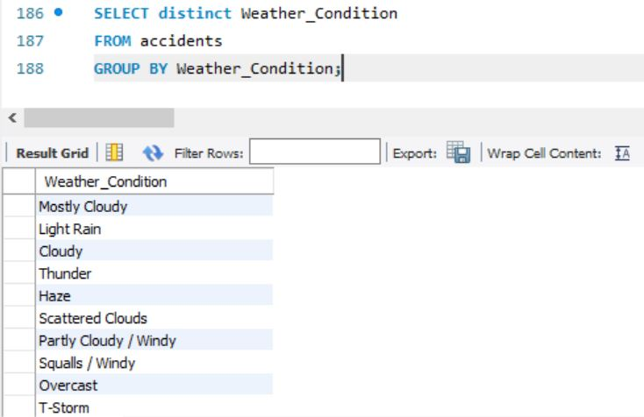

Slide 30
5
CREATING AN
API

Slide 31
HERE WE DISCUSS THE CREATION OF AN API TO FACILITATE THE DATA ACCESS.
Steps to create an API for accessing accident data.
Key endpoints and their functionalities.
Example of an API call.

Slide 32
API created using Pymysql and Flask.
Chosen endpoints: top states, accidents by city, state, weather condition.
Now let’s see an example of an API call to fetch top 20 cities accident data by state.

Slide 33
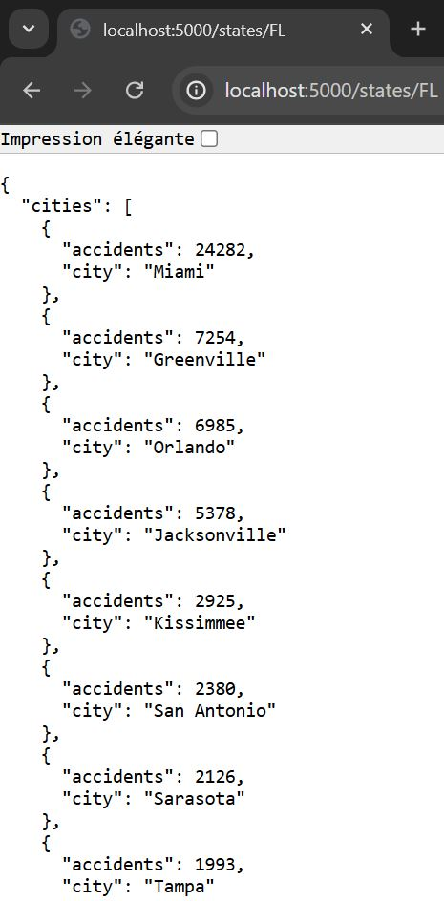

Slide 34
6
MACHINE
LEARNING

Slide 35
HERE WE EXPLORE THE MACHINE LEARNING MODELS USED TO PREDICT ACCIDENT SEVERITY.
Overview of machine learning models used to predict accident severity.
Data preprocessing steps.
Example of a model used: Random Forest Classifier.

Slide 36
To predict impact on traffic (severity), the following models have been used: decision tree regressor, bagging regressor then bagging classifier, random forest classifier, adaboost classifier and Kneighbors.
Each time the dataframe is divided in two parts: test and train.
Now let’s see what our best model looks like.

Slide 37
FEATURES AND TARGET SELECTION
In order to predict impact on traffic (severity), measurement features are selected to be able to build a strong model.
These reflect driving condition and can be reproduced in all future situations.
They are therefor a great choice to build a strong model.

Slide 38
MACHINE LEARNING SCORES
BAGGING REGRESSOR
0,004
DECISION TREE REG.
0,026
BAGGING CLASSIFIER
0,942
RANDOM FOREST CLASS.
0,944
ADABOOST
0,943
KNEIGHBORS
ACCURACY
0,94

Slide 39

WHAT HAVE WE LEARNED

Slide 40
KEY FINDINGS
ACCIDENTS ARE NOT WEATHER RELATED
ACCIDENTS ARE HOUR RELATED
ACCIDENTS ARE DAY RELATED
ACCIDENTS ARE SEASON RELATED

Slide 41
CONCLUSION
The comprehensive analysis of road accidents from 2016 to 2023 has provided valuable insights into the factors contributing to accidents, the most affected areas, and the times when accidents are most likely to occur. Through exploratory data analysis and visualizations, we identified key patterns and trends. The machine learning models demonstrated the potential to predict accident severity, aiding in proactive measures to enhance road safety. Nevertheless, there is room for further research, including incorporating more recent data, exploring additional features, and applying advanced deep learning techniques.

Slide 42


Slide 43
THANK
YOU !

